Slide 1
Microfluidic system for label-free chemical/biological detection using nanowire FET sensors
Christy Contreras
Physics Department, Arizona State University

Slide 2
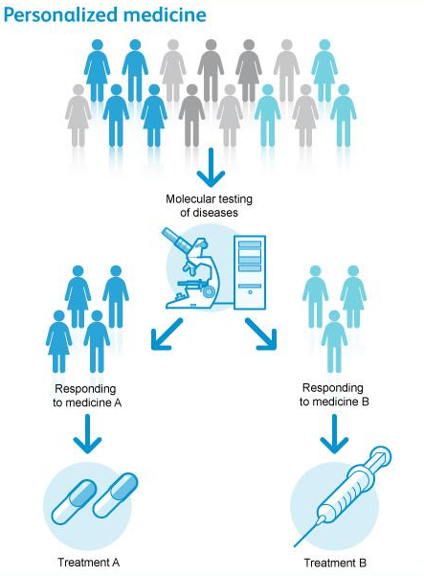
Motivation: Personalized Medicine

Slide 3
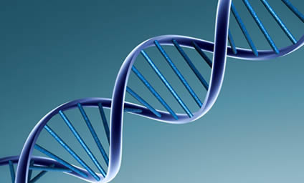
Motivation: Personalized Medicine

Slide 4

Motivation: Personalized Medicine

Slide 5
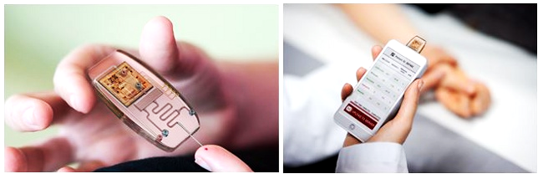
Proposed Solution: An Integrated System
Innovative and powerful integrated technology

Slide 6
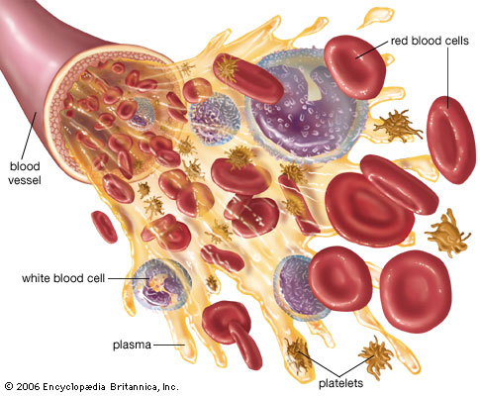
Proposed Solution: An Integrated System
Innovative and powerful integrated technology
Able to handle small liquids and detect biomolecules like protein and DNA

Slide 7
Proposed Solution: An Integrated System
Innovative and powerful integrated technology
Able to handle small liquids and detect biomolecules like protein and DNA
Revolutionary tool for biomedical applications and disease diagnostics

Slide 8
Proposed Solution: An Integrated System
Innovative and powerful integrated technology
Able to handle small liquids and detect biomolecules like protein and DNA
Revolutionary tool for biomedical applications and disease diagnostics
Two components: an FET biosensor and a microfluidic platform

Slide 9
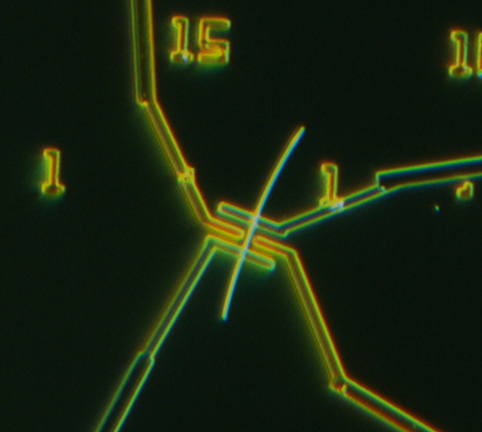
What are FET biosensors and how do they work?
Gate 2
Source
Drain
Gate 1
40um
Dimensions: Silicon nanowire 30 nm in diameter, gate gap distance is 2 um

Slide 10
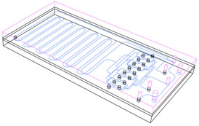
What are FET biosensors and how do they work?
Silicon nanowire
Gate electrode pair
Gate 2
Source
Drain
Gate 1
40um
Source and drain electrodes
Dimensions: Silicon nanowire 30 nm in diameter, gate gap distance is 2 um

Slide 11
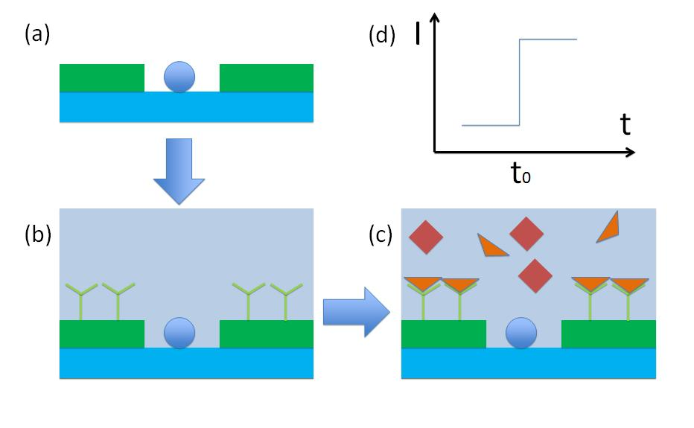
What are FET biosensors and how do they work?
Silicon nanowire
Gate electrode pair
Gate 2
Source
Drain
Gate 1
40um
Source and drain electrodes
Dimensions: Silicon nanowire 30 nm in diameter, gate gap distance is 2 um
Gate electrode pair
Silicon
nanowire
Antibody modification of electrode gates

Slide 12
What are FET biosensors and how do they work?
Silicon nanowire
Gate electrode pair
Gate 2
Source
Drain
Gate 1
40um
Source and drain electrodes
Dimensions: Silicon nanowire 30 nm in diameter, gate gap distance is 2 um
Antibody
modification
Gate electrode pair
Silicon
nanowire
Antibody modification of electrode gates
Antigen recognition and binding events occur

Slide 13
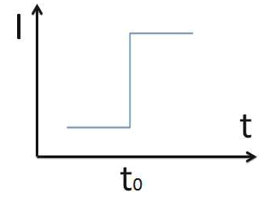
What are FET biosensors and how do they work?
Silicon nanowire
Gate electrode pair
Gate 2
Source
Drain
Gate 1
40um
Source and drain electrodes
Dimensions: Silicon nanowire 30 nm in diameter, gate gap distance is 2 um
Gate electrode pair
Silicon
nanowire
Antibody modification of electrode gates
Antigen recognition and binding events occur
Signal change occurs when antigen flow is introduced

Slide 14
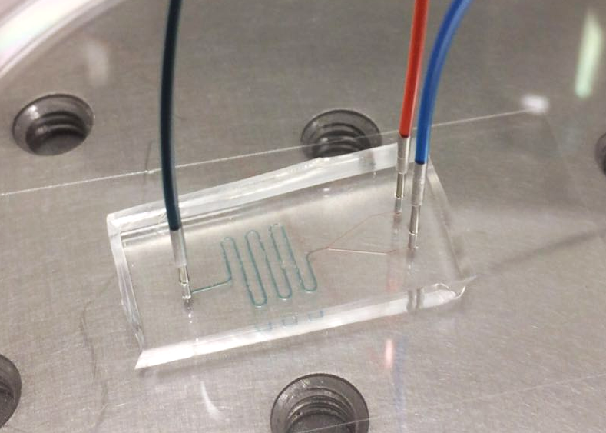
What is a microfluidic system and why is it useful?
Microfluidics is a network of micro-sized channels that handle small fluid samples
Inlets
Outlet
Micro-channels

Slide 15
What is a microfluidic system and why is it useful?
Microfluidics is a network of micro-sized channels that handle small fluid samples
Used to mix, sort, and transfer fluids
Inlets
Outlet
Micro-channels

Slide 16
What is a microfluidic system and why is it useful?
Microfluidics is a network of micro-sized channels that handle small fluid samples
Used to mix, sort, and transfer fluids
Come in various arrays of patterns and designs depending on the purpose
Inlets
Outlet
Micro-channels

Slide 17
What is a microfluidic system and why is it useful?
Microfluidics is a network of micro-sized channels that handle small fluid samples
Used to mix, sort, and transfer fluids
Come in various arrays of patterns and designs depending on the purpose
Properties:
Inlets
Outlet
Micro-channels

Slide 18
What is a microfluidic system and why is it useful?
Microfluidics is a network of micro-sized channels that handle small fluid samples
Used to mix, sort, and transfer fluids
Come in various arrays of patterns and designs depending on the purpose
Properties:
  Inexpensive and compact
Inlets
Outlet
Micro-channels

Slide 19
What is a microfluidic system and why is it useful?
Microfluidics is a network of micro-sized channels that handle small fluid samples
Used to mix, sort, and transfer fluids
Come in various arrays of patterns and designs depending on the purpose
Properties:
  Inexpensive and compact
  Multiple inputs
Inlets
Outlet
Micro-channels

Slide 20
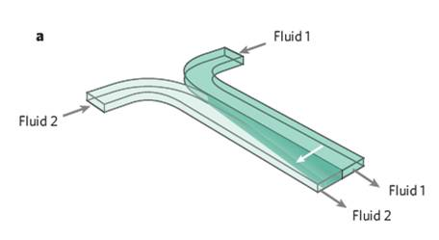
What is a microfluidic system and why is it useful?
Microfluidics is a network of micro-sized channels that handle small fluid samples
Used to mix, sort, and transfer fluids
Come in various arrays of patterns and designs depending on the purpose
Properties:
  Inexpensive and compact
  Multiple inputs
  Laminar flow (diffusion mixing)
Inlets
Outlet
Micro-channels

Slide 21
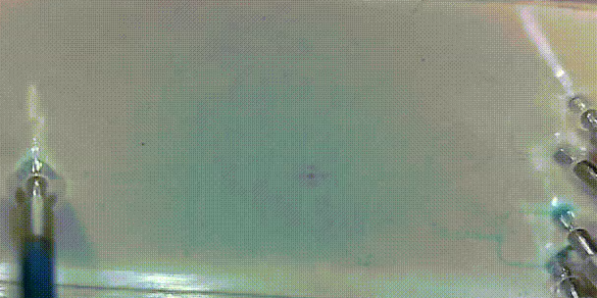
Microfluidic System Demonstration
Channel width: 50um, 100um, 200um

Slide 22
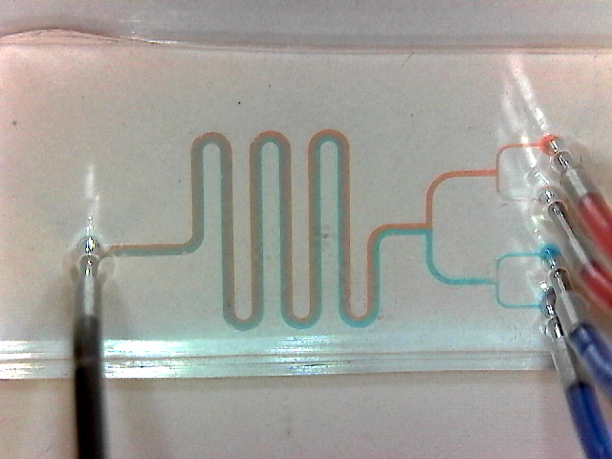
Microfluidic System Demonstration
Channel width: 50um, 100um, 200um

Slide 23
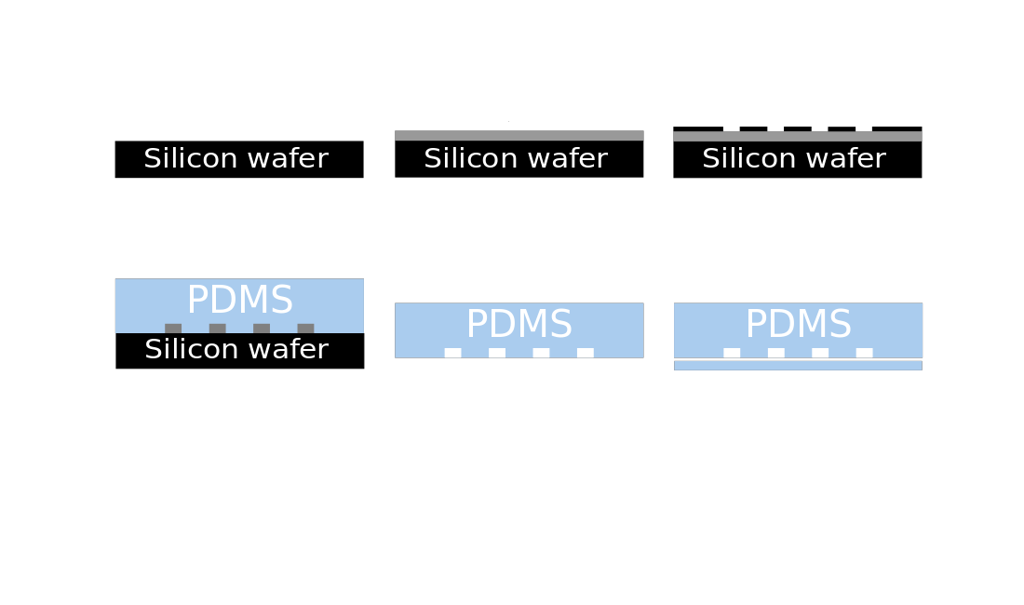
Microfluidic Chip Fabrication
1
Coat with SU-8
SU-8

Slide 24
Microfluidic Chip Fabrication
1
Coat with SU-8
2
Place mask & expose
SU-8
UV exposure

Slide 25
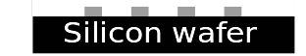
Microfluidic Chip Fabrication
1
Coat with SU-8
2
Place mask & expose
3
Wash away SU-8 and cure
SU-8
UV exposure

Slide 26
Microfluidic Chip Fabrication
1
Coat with SU-8
2
Place mask & expose
3
Wash away SU-8 and cure
SU-8
UV exposure
4
Pour PDMS

Slide 27
Microfluidic Chip Fabrication
1
Coat with SU-8
2
Place mask & expose
3
Wash away SU-8 and cure
SU-8
UV exposure
4
Pour PDMS
5
Peel off mold

Slide 28
Microfluidic Chip Fabrication
1
Coat with SU-8
2
Place mask & expose
3
Wash away SU-8 and cure
SU-8
UV exposure
4
Pour PDMS
5
Peel off mold
6
Bond to glass slide

Slide 29
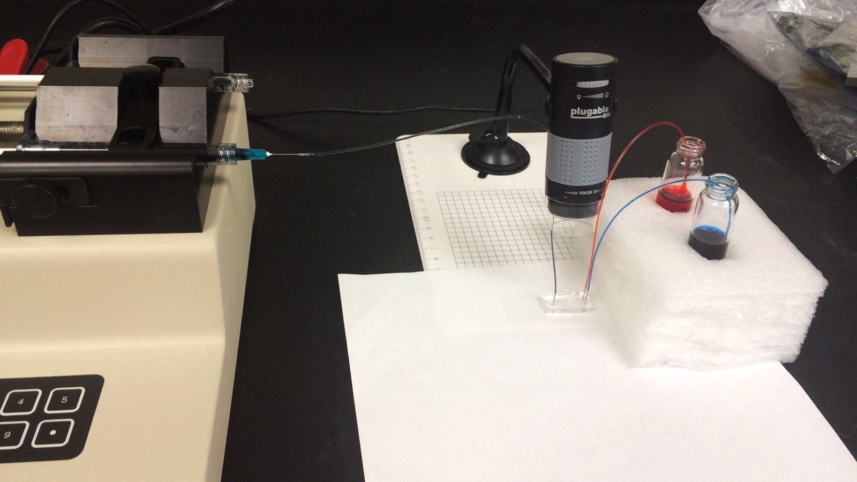
Experiment Setup
Tubing
Syringe
Microscope
Syringe Pump
Food Coloring
Microfluidic chip

Slide 30
Summary of Results
We were able to fabricate a microfluidic device and show the laminar flow occurring, but we saw that diffusion did not occur inside the channel. We want calculate how long the channel must be in order for diffusion mixing of liquids to occur.

Slide 31
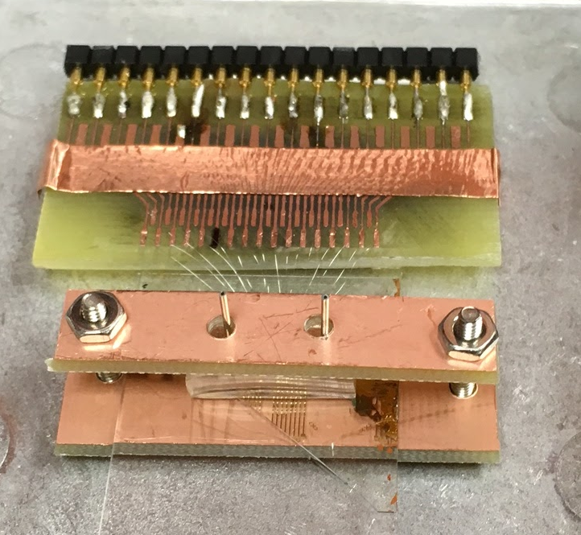
Future Experiments
Currently we are testing the alignment and bonding of a simple microfluidic device on the nanowire FET.
Upcoming work:
We eventually want to run some pH sensing tests on the nanowire FET biosensor. Later we will do protein recognition tests.

Slide 32

Acknowledgements
Research mentor: Dr. Quan Qing
Lab partners: Yuan Wang, Xiangbing Liao, Joshua Sadar
Research Funding: ASU/NASA Space Grant

Slide 33
Thank you for your attention!
Any Questions?
Christy Contreras
ccontr11@asu.edu

